Slide 1

Capstone Project (Exploratory data analysis) Global Terrorism Dataset
-by Ashu Koche

Slide 2
Content
Introduction
Exploring Dataset
Data Summary
Problem Statement
Data Cleaning and Handling
Data Visualization
Solutions to Business objective
Conclusion/Recommendations

Slide 3
Introduction
Global terrorism is a complex and constantly evolving phenomenon that poses a significant threat to global security and stability. In recent years, there has been a growing interest in using data-driven approaches to better understand the patterns, trends, and dynamics of terrorism around the world.
The Global Terrorism Database (GTD) is a comprehensive dataset of terrorist events around the world from 1970 to 2017. The dataset contains over 181,691 incidents, including information on the date, location, weapons used, and casualties.

Slide 4
Introduction
In this project, I have use Python to explore and analyze the GTD, with the goal of gaining insights into the patterns and trends of global terrorism.
This project aims to contribute to a better understanding of the causes and consequences of terrorism, and to inform policy and practice in the fields of security, conflict resolution, and development.
I have used various Python libraries and tools, such as NumPy, Pandas, Matplotlib, to explore the data and answer questions such as:
Which countries are most affected by terrorism, and what factors contribute to their vulnerability?
What are the most common types of terrorist attacks?
What is the number of attacks in specified regions? etc….

Slide 5
Exploring Dataset
The Global Terrorism Database (GTD) is a well-known open-source dataset that contains information on terrorist attacks around the world from 1970 to 2017, containing 206 Countries.
The dataset has 181691 rows and 135 columns. There are a ratio of 3/5 null values in the dataset and no duplicate values in it.
In the given Dataset, most of the columns consist null values but those columns on which the EDA have been conducted or questions have been analysed do not contain the problem of null values.
From these 135 columns, I have used only 26 columns that have the most important information in them.
The 26 columns contain information of such as date, month, year, countries name, motive, region, attack type, and weapon type.
In some data, the information is incomplete no month and date available of the attack and also which property was damaged. So, this data set kept those values as Unknown.

Slide 6
Exploring Dataset
The name of the columns doesn't have the proper format to understand so, I have renamed them accordingly. Below are some column names with information in it:
iyear :Year of the attack
imonth :Month of the attack
iday :Date of the attack
country_txt :The names of the 205 attacked countries
region_txt :12 Region
city :The city's name, which was attacked
attacktype1_txt :The list of attack type
targtype1_txt :The main target of the attack
motive :Motive of the attack
weaptype1_txt :The types of weapons used to attack the country/region
propextent_txt :Range of cost for the property destroyed
propvalue :The actual cost of the property destroyed

Slide 7
Data Summary
df: It contains all the important 26 columns which are extracted from the df_main which is the main data set.
country_attacked: This data set contains the total number of attacks on countries, it having 205 countries' names.
Year_of_attacke: This set includes the count of attacks every year and also the trend of attacks.
weapons_used: Types of weapons used in terrorist attacks.
property_loss: This dataset was used to identify the loss of property.
loss_of_property_country_wise: This dataset also was used to identify the loss of property however country-wise.
region_wise_property_loss: This dataset contains the loss of property Region-wise.
choro_df: It includes the count of the attack region wise.
attack_file: The dataset contains the target type and attack type of the attacker’s Region-wise.

Slide 8
Problem Statement
Terrorism is a complex and multifaceted phenomenon that affects countries and communities around the world.
The Global Terrorism Database (GTD) is a valuable resource for studying the patterns and trends of terrorism, but analyzing such a large and complex dataset can be a daunting task.
What are the limitations of the Global Terrorism Database, and how might these impact our analysis and conclusions?
How can the insights from our analysis be used to inform policy decisions and improve counter-terrorism strategies?
How accurate is our predictive model, and what factors contribute to its success or failure?

Slide 9
Problem Statement
The project will address the following questions:
Which countries are most affected by terrorism, and what factors contribute to their vulnerability?
What are the most common types of terrorist attacks?
How do they impact different parts of the world?
How has the frequency of terrorist attacks changed over time?
Are there any patterns or trends in the types of weapons used in terrorist attacks?
Which types of weapons are used most in different types of attacks?
What is the number of attacks in specified regions?
What is the categorisation of different affected property types in various Regions.
Which weapons are used in specific regions according to the target type?

Slide 10
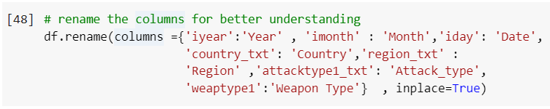
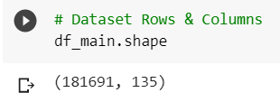
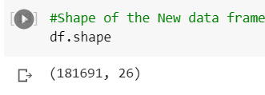
Cleaning and Handling Dataset
There are no duplicate columns but it having the many unique values in it.
Created a copy of the dataset so that the original dataset cannot be harmed.
Column names of this dataset have different names than usual hence rename them accordingly to easily understand. eg. {'iyear':'Year' , 'imonth' : 'Month','iday': 'Date', 'country_txt': 'Country','region_txt' : 'Region' ,'attacktype1_txt': 'Attack_type', 'weaptype1':'Weapon Type'}
Extracted the only important 26 columns to the new dataset which has the most important data to find the insights.

Slide 11
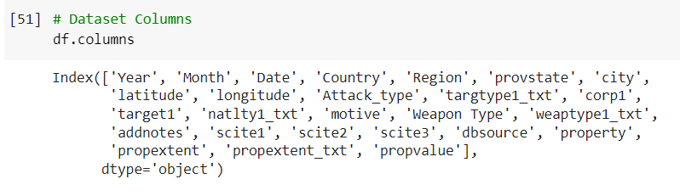
Cleaning and Handling Dataset
These are the 26 columns that I have extracted.
provstate: State which was attacked
city: City of attack
latitude: The latitude of the attack location
longitude: The longitude of the attack location
Attack_type: The type of attack
targtype1_txt: The type of target.
corp1: The incident belongs to corporate
target1: Who is the target!
natlty1_txt: Country
motive: Motive of the attacker
addnotes: Notes about the attack
scite1, scite2, scite3: Brief notes about the attack
propextent_txt: Tyme of property destroyed according to cost
propvalue: The cost of the property destroyed

Slide 12
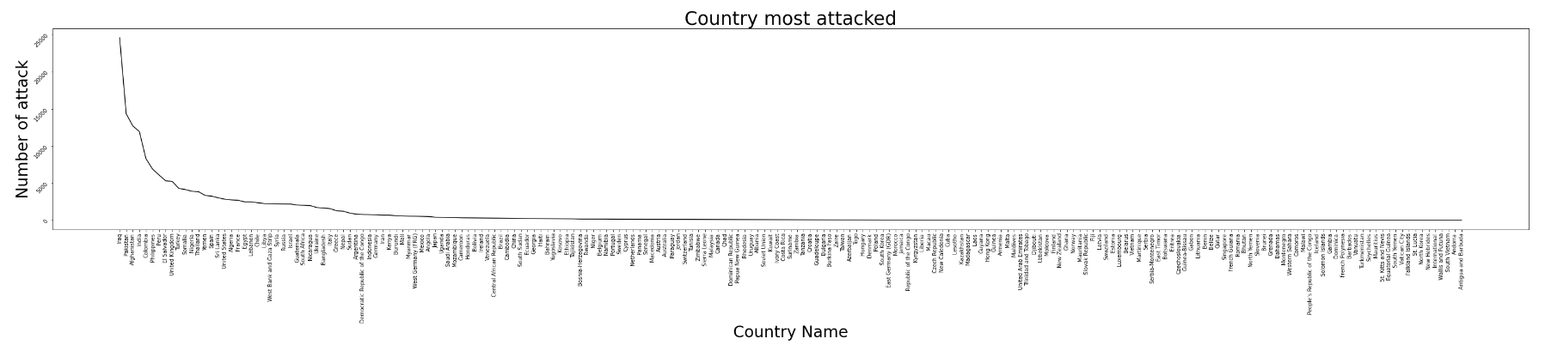
Data Visualization
Countries that have experienced the most terrorist attacks
From the below Lineplot, we can able to identify the top 10 countries that were attacked the most and the 10 safest countries to be counted with a smaller number of attacks.
We can analyze that the most attacked country is Iraq, Pakistan, Afghanistan, India, Colombia, Philippines, Peru, El Salvador, United Kingdom, and Turkey.

Slide 13
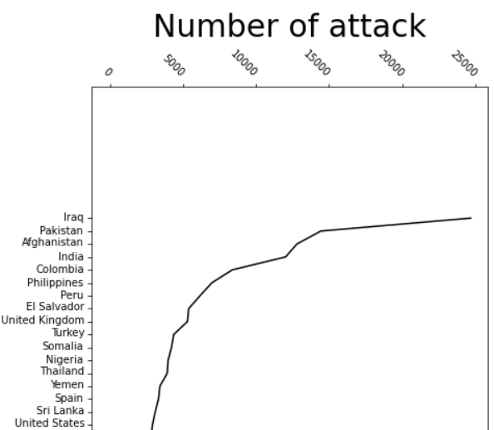
Data Visualization
Iraq | 24636
Pakistan | 14368
Afghanistan | 12731
India | 11960
Colombia | 8306
Philippines | 6908
Peru | 6096
El Salvador | 5320
United Kingdom | 5235
Turkey | 4292
Vatican City | 1
Falkland Islands | 1
St. Lucia | 1
North Korea | 1
New Hebrides | 1
International | 1
Wallis and Futuna | 1
South Vietnam | 1
Andorra | 1
Antigua and Barbuda | 1
This Dataset is very useful to understand the core depth of the security followed by the countries, which needs to be improved.

Slide 14
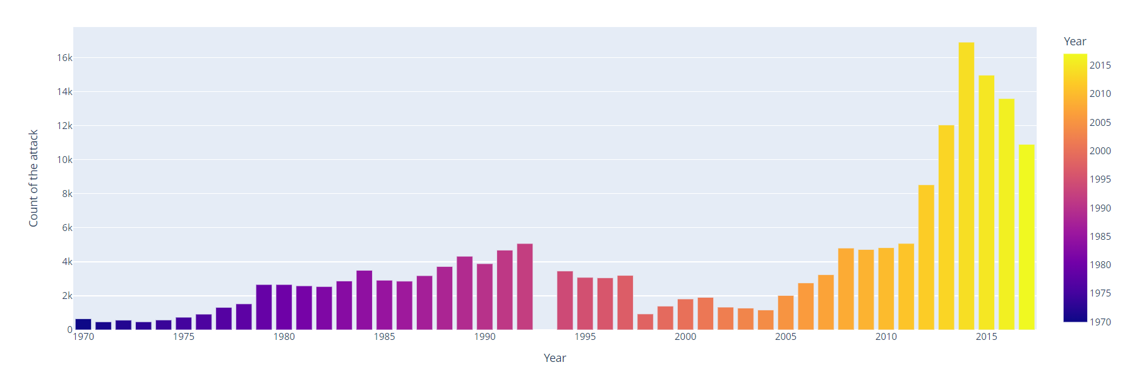
Data Visualization
The frequency of terrorist attacks changed over time
The Barplots represent the value count of the attack every year. The significant attacks were happened in 2014. Also, the number of terrorist attacks is increasing every year.
If we observe between 2000 to 2005 the attacks were slightly reduced compared to the rest of the years. Also, after 2014 the attack ratio is reducing in 2015,2016, and 2017. That represents after 2014 the countries are taking small steps to improve security on a priority basis.

Slide 15
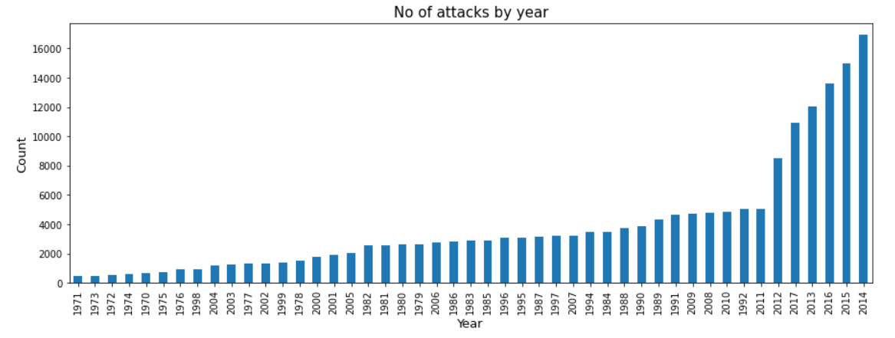
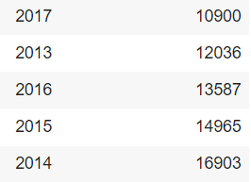
Data Visualization
Year No of attacks
Calculating the number of terrorist attacks on countries can help in assessing the level of risk of terrorist attacks for businesses or organizations operating in those countries. So that they can improve security.

Slide 16
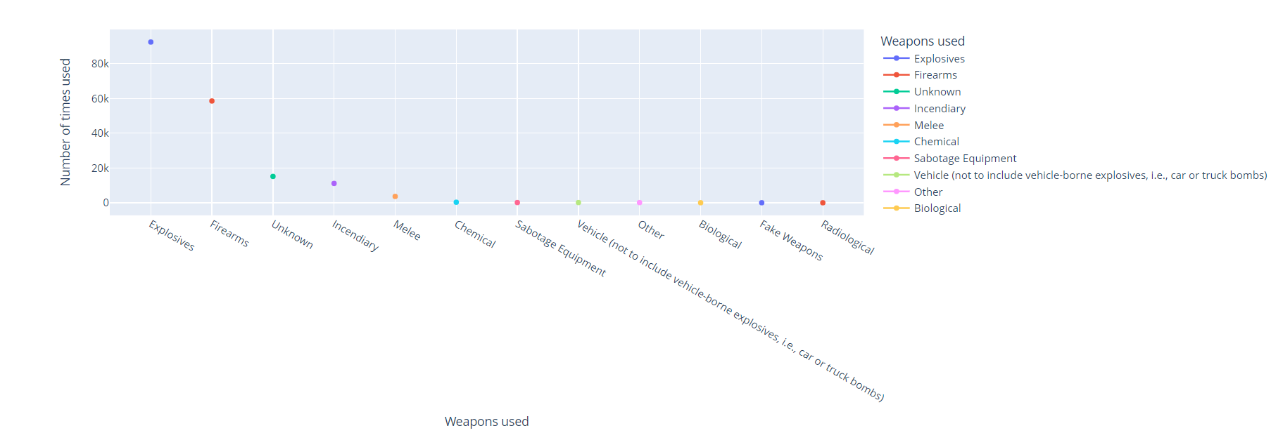
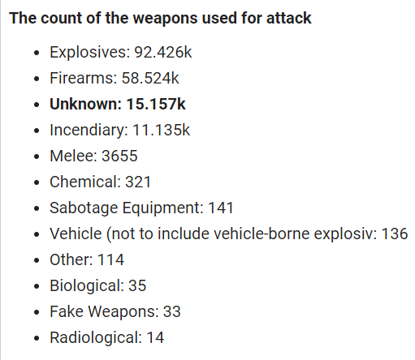

Data Visualization
The patterns or trends in the types of weapons used in terrorist attacks.
From above Line plot the types of weapons used in terrorist attacks is providing the insight into the types of weapons that are most commonly used by terrorists which is Explosives and Firearms. This can suggest that the group has access to more sophisticated and advanced weapons.
The Unknown weapon used in attack, it may increase the risk of copycat attacks by other groups or individuals. The lack of information about the weapon used may make it easier for other groups to emulate the attack or develop similar tactics, making it more challenging for us to prevent future attacks.

Slide 17
Data Visualization
Types of weapons used in most in different types of attacks
Explosives : 92.426k
Pipe Bomb
Dynamite/TNT
Pressure Trigger
Time Fuse
Vehicle
Letter Bomb
Grenade
Landmine
Firearms : 58.524k
Unknown Gun Type
Automatic or Semi-Automatic Rifle
Handgun
Rifle/Shotgun (non-automatic)
Incendiary : 11.135k
Molotov Cocktail/Petrol Bomb
Gasoline or Alcohol
Arson/Fire
Chemical : 11.135k
Poisoning
Explosive
Unknown
Unknown: 15.157k
Melee : 3.655k
Blunt Object
Knife or Other Sharp Object
Hands, Feet, Fists
Suffocation
Rope or Other Strangling Device
Unknown Weapon Type
Here the weapon used in a terrorist attack is Unknown, it may be more difficult to analyze the attack and draw conclusions. The lack of information about the weapon used can limit the available data and make it harder to draw definitive insights.

Slide 18
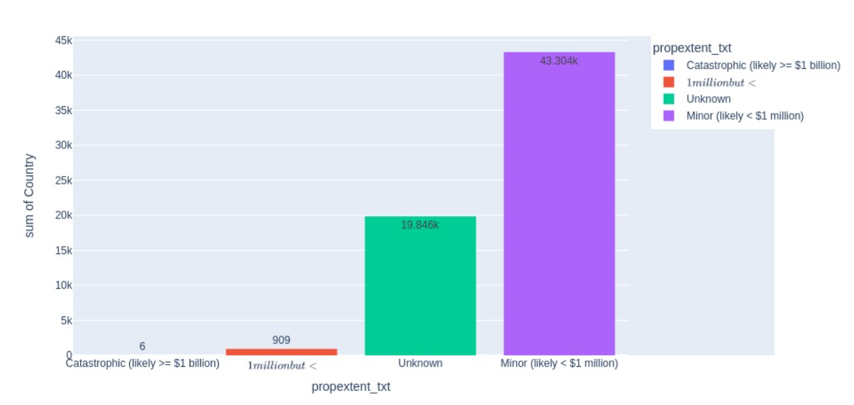
Data Visualization
Visualizing of lost property in an attack
The above bar plot provides the impact of terrorism on infrastructure, the economy, and the local population. It is showing the cost of repairing or replacing damaged infrastructure, lost productivity, and the impact on tourism and other industries.
We can identify that most of the suffering people are lower-class people which falls under the property loss below $1 million.
Catastrophic (likely >= $1 billion) = 6
Major (likely >= $1 million but < $1 billion) = 909
Unknown = 19.846k
Minor (likely < $1 million) = 43.304k

Slide 19
Data Visualization
Catastrophic (likely >= $1 billion) = 6
Destroyed historic buildings and damaged surrounding buildings, estimated at $2,700,000,000 (London financial district)
1996: Huge explosion rocks central Manchester.
The crash of the plane resulted in the destruction of an American Airlines Boeing 767 aircraft.
Major (likely >= $1 million but < $1 billion) = 909
Store destroyed
Building partially destroyed
Warehouse destroyed and buildings in Oxford damaged
Auditorium, including the floor and the roof. Archive and part of the library, as well as a transformer station.
Petroleum storage tanks
Unknown = 19.846k
Minor (likely < $1 million) = 43.304k
Transformers were damaged.
Basketball courts, swimming pool, gymnastic equipment, Windows shattered, Restroom damaged.
Army personnel carrier was damaged
Numerous other vehicles damaged
Class rooms and offices were destroyed.

Slide 20
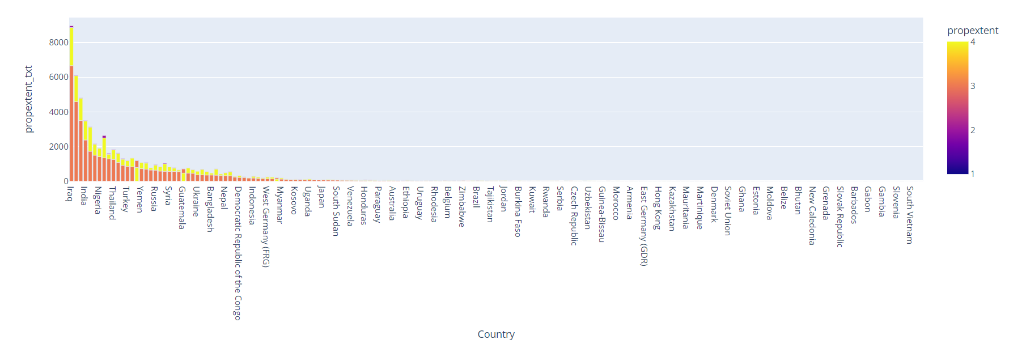
Data Visualization
The categorisation of different affected property types in various Regions.
This histogram shows how much the countries suffered from property loss with every attack.
The most affected countries are Iraq, Pakistan, Afghanistan, India, El Salvador, Philippines, Nigeria, Colombia, United States, Thailand, and Peru.
The above data it is reflecting that the number of attacks on countries is directly proportional to the loss of property.

Slide 21
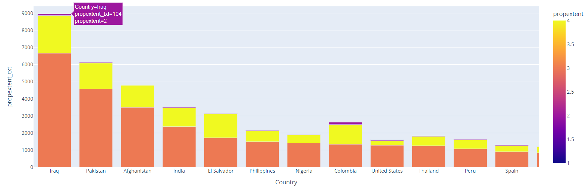
Data Visualization
Pakistan
Minor (likely < $1 million) = 4583
Unknown = 1580
Major (likely >= $1 million but < $1 billion) = 42
Afghanistan
Minor (likely < $1 million) = 3500
Unknown = 1289
India
Minor (likely < $1 million) = 2376
Unknown = 1092
Major (likely >= $1 million but < $1 billion) = 31
Iraq
Minor (likely < $1 million) = 6665
Unknown = 2200
Major (likely >= $1 million but < $1 billion) = 104

Slide 22
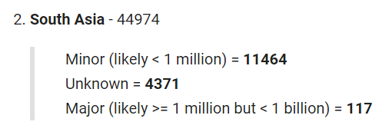
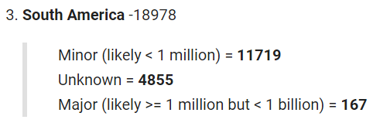
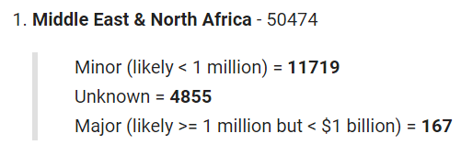
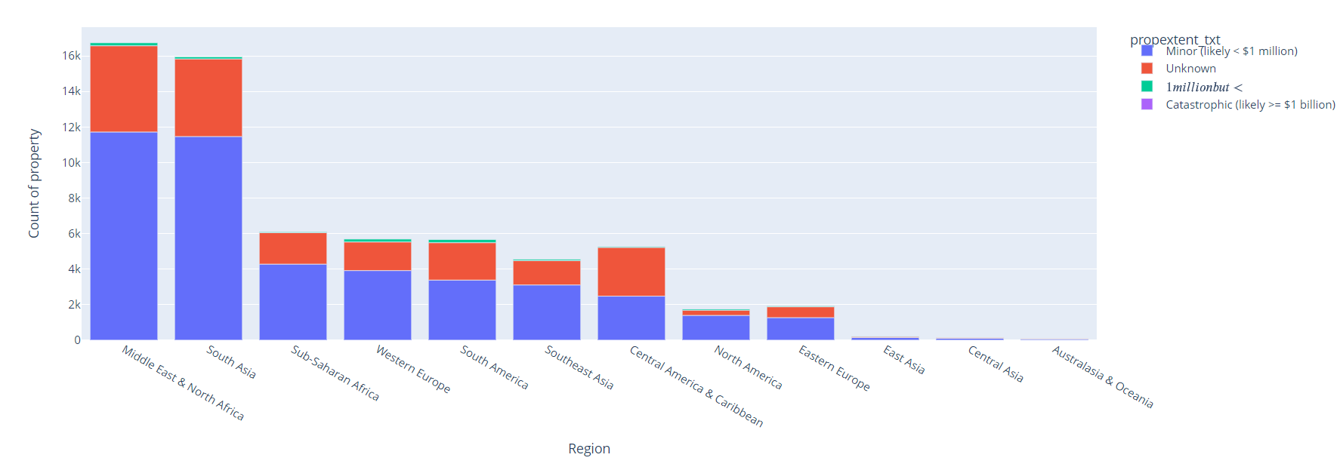
Data Visualization
The information would help countries common in the region to cultivate a cumulative and collective plan against terrorist attacks. Also, to make the economy strong enough to sustain such attack.

Slide 23

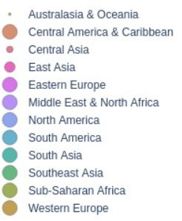
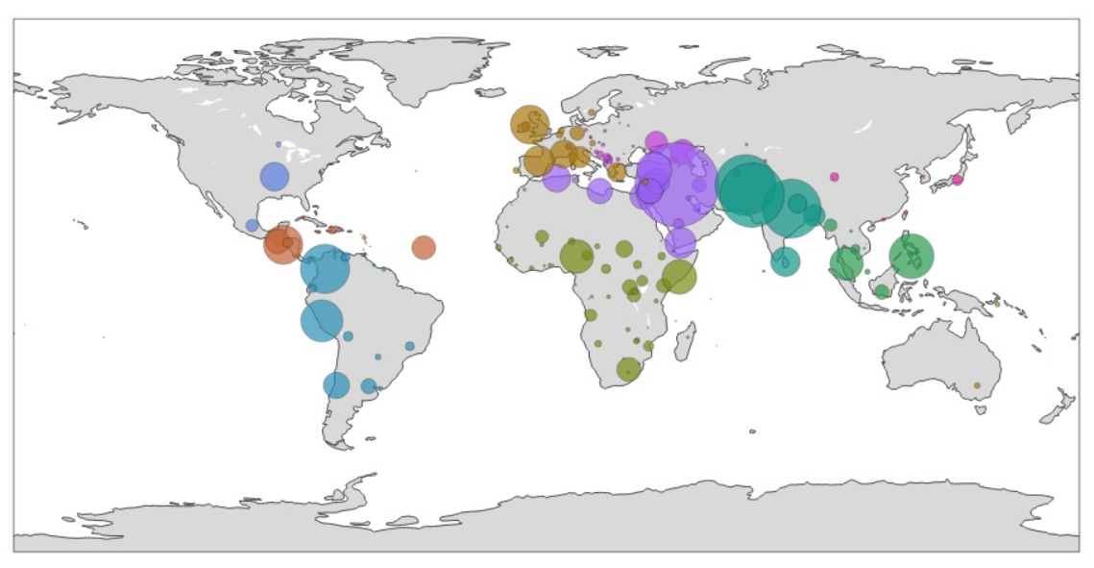
Data Visualization
The number of terror attacks, encountered by individual region.
Analyzing the property destroyed in terrorist attacks over different regions can provide insights into the economic impact of terrorism in those regions. This includes the cost of repairing or replacing damaged infrastructure, lost productivity, and the impact on tourism and other industries.

Slide 24
Data Visualization
The Choropleth is showing the most impacted Region is the Middle East & North Africa. The Region which is less affected by this attack over the cost is Australasia & Oceania. The major loss of the region
The property destroyed in terrorist attacks over different regions over time can reveal trends in the types of targets being attacked and the impact of those attacks.
The major loss of the region Middle East & North Africa as well as South Asia affects all the economic growth hence this region needs to develop strategies to address those vulnerabilities.
E.g In Western Europe, the number of attacks encountered by Private Property due to Armed Assaults.It gives the idea about, most notorious attack type , their frequency and most vulnerable target in every region.

Slide 25
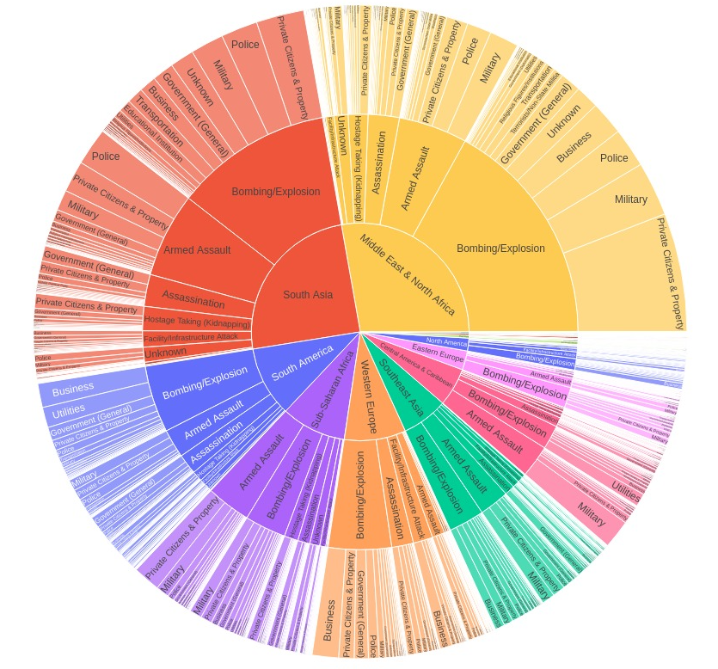
Data Visualization
The number of attacks on different target types according to the different attack types specified in the Region
Sunburst provides some beautiful functionalities to users. The Data consists of some interlinkages with each other. So, to represent the relation between 'Region' and 'Attack Type' it is the most suitable graph.
In most of the regions,Bombing and Explosions is the most frequent attack type.Nearly every region is severely affected due to the Bombing and Explosions.
The number of attacks on different target types according to the different attack types specified in the Region.
When countries got to know about the most frequent attack type, they work directly on prevention and dissemination of weapons related to the attack type.It will help them to regulate the law and order according to the type of attack.

Slide 26
Solutions to Business objective
The Countries must work on comprehensive anti terror policies. Such Policies can be formulate in organisation like United Nations Security Councils.
In today's new World order multilateralism is appreciated by most of the regions and their respective countries. This new way of diplomacy could also be helpful for curbing the menace of terrorism.
Economy , Polity or Science could change with time and fluctuate but the Geography of countries never changed. If the same geography remained attached and aligned, where focus is on dissolving the boundaries and not demarcating the boundaries , problems like terrorism can never dominate over strong steadfast stature of countries.
So deep connection between countries, people to people relations , respecting each other's foreign policy and not involving with any non state actors(for any kind of ill attack) will fetch countries strength and resilience to fight through any terror attacks.

Slide 27
Conclusions
Analyzing the effectiveness of counterterrorism policies and strategies can help to identify areas where improvements could be made.
Exploring the Global Terrorism Dataset can help to identify trends and patterns in terrorist attacks over time, such as changes in the frequency, location, or methods of attacks.
When the Taliban took control of Afghanistan, the whole world felt the grief of the Afghan people. Terrorism destroys every right and batters the person to his frightening death.
In the above analysis, various study heads have been found which could be easily studied by countries to curb the menace of terrorism.
Terrorism do not just destroys the land but it destroys the peace,harmony, trust on humanity, the whole youth and cultivates the seeds of hatred and envy.

Slide 28
Thank You!!

